Slide 1
#HealthierMO Transforming the future of public health in Missouri

Slide 2
Notes:
All of us who live in Missouri deserve the fair opportunity for health, but where a person lives can determine how healthy he can be and how long she will live.
Equity means that everyone has a fair and just opportunity to be as healthy as possible.
But for the 115 autonomous public health agencies in Missouri, assuring equitable programs and services can be challenging.
Limited resources create a significant gap between what local public health agencies want to provide and what they are able to provide.

Slide 3
Notes:
Differences in funding and revenue
Pockets of funding may improve opportunities for some Missourians, but don’t benefit everyone equally.
Missouri needs a stronger, more equitable public health system, guided by local public health agencies (LPHAs) committed to assuring that critical public health services are in place to protect the health of every Missourian.

Slide 4
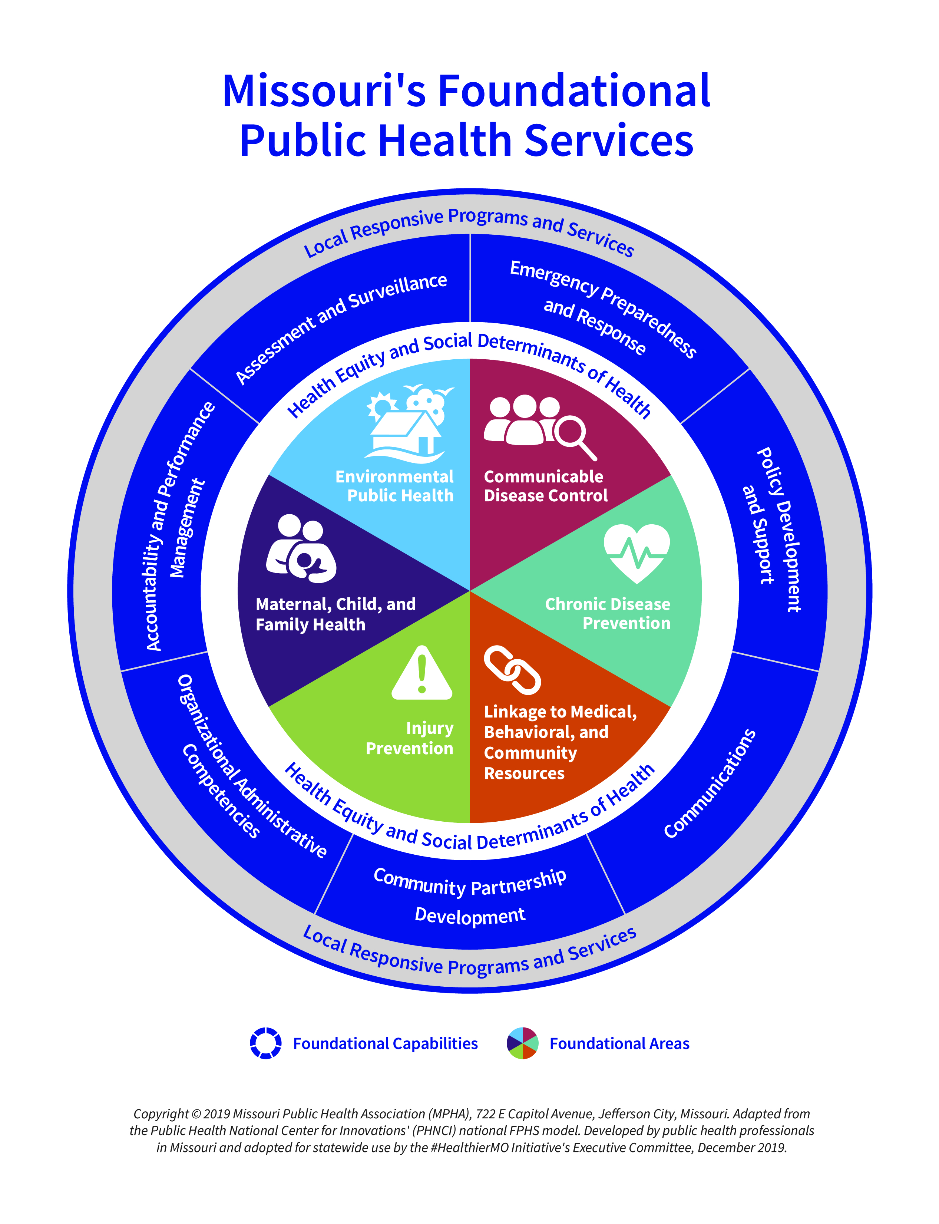
Notes:
[replace with video clip of light traveling]
In 2019, stakeholders from state and local public health and universities in Missouri worked together to define a fundamental set of public health services and capabilities that must be assured in every community.
The result was a simplified operational framework called the Foundational Public Health Services Model.

Slide 5
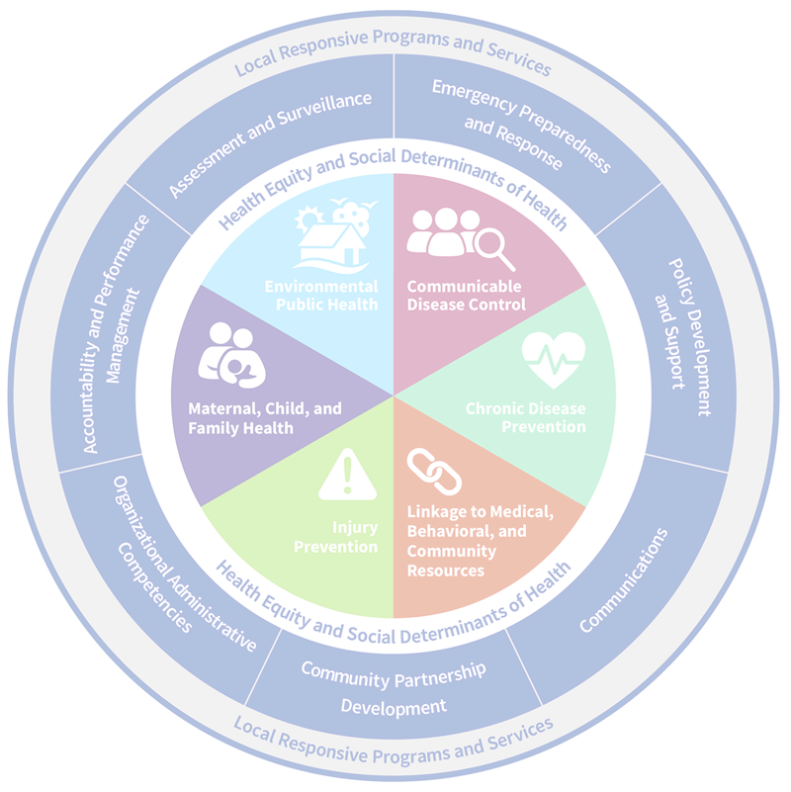
FPHS model defines
a minimum set of fundamental public health services and capabilities that must be available in every community in order to have a functional public health system
HealthierMO.org
Notes:
The FPHS model describes the unique responsibilities of governmental public health to assure a minimum set of public health capabilities and areas of expertise that must be available in every community in order for Missouri’s public health system to function.

Slide 6
Model benefits
Builds on existing models
Consistent description
Simplified operational framework
Identify capacity gaps
Attach costs
Justify funding
HealthierMO.org
Notes:
It builds on the 10 Essential Services and Core Public Health Functions and provides public health agencies a tool to explain the vital role of governmental public health in a thriving community, identify capacity gaps, determine the cost for assuring foundational public health capabilities and areas, and justify funding requests.

Slide 7
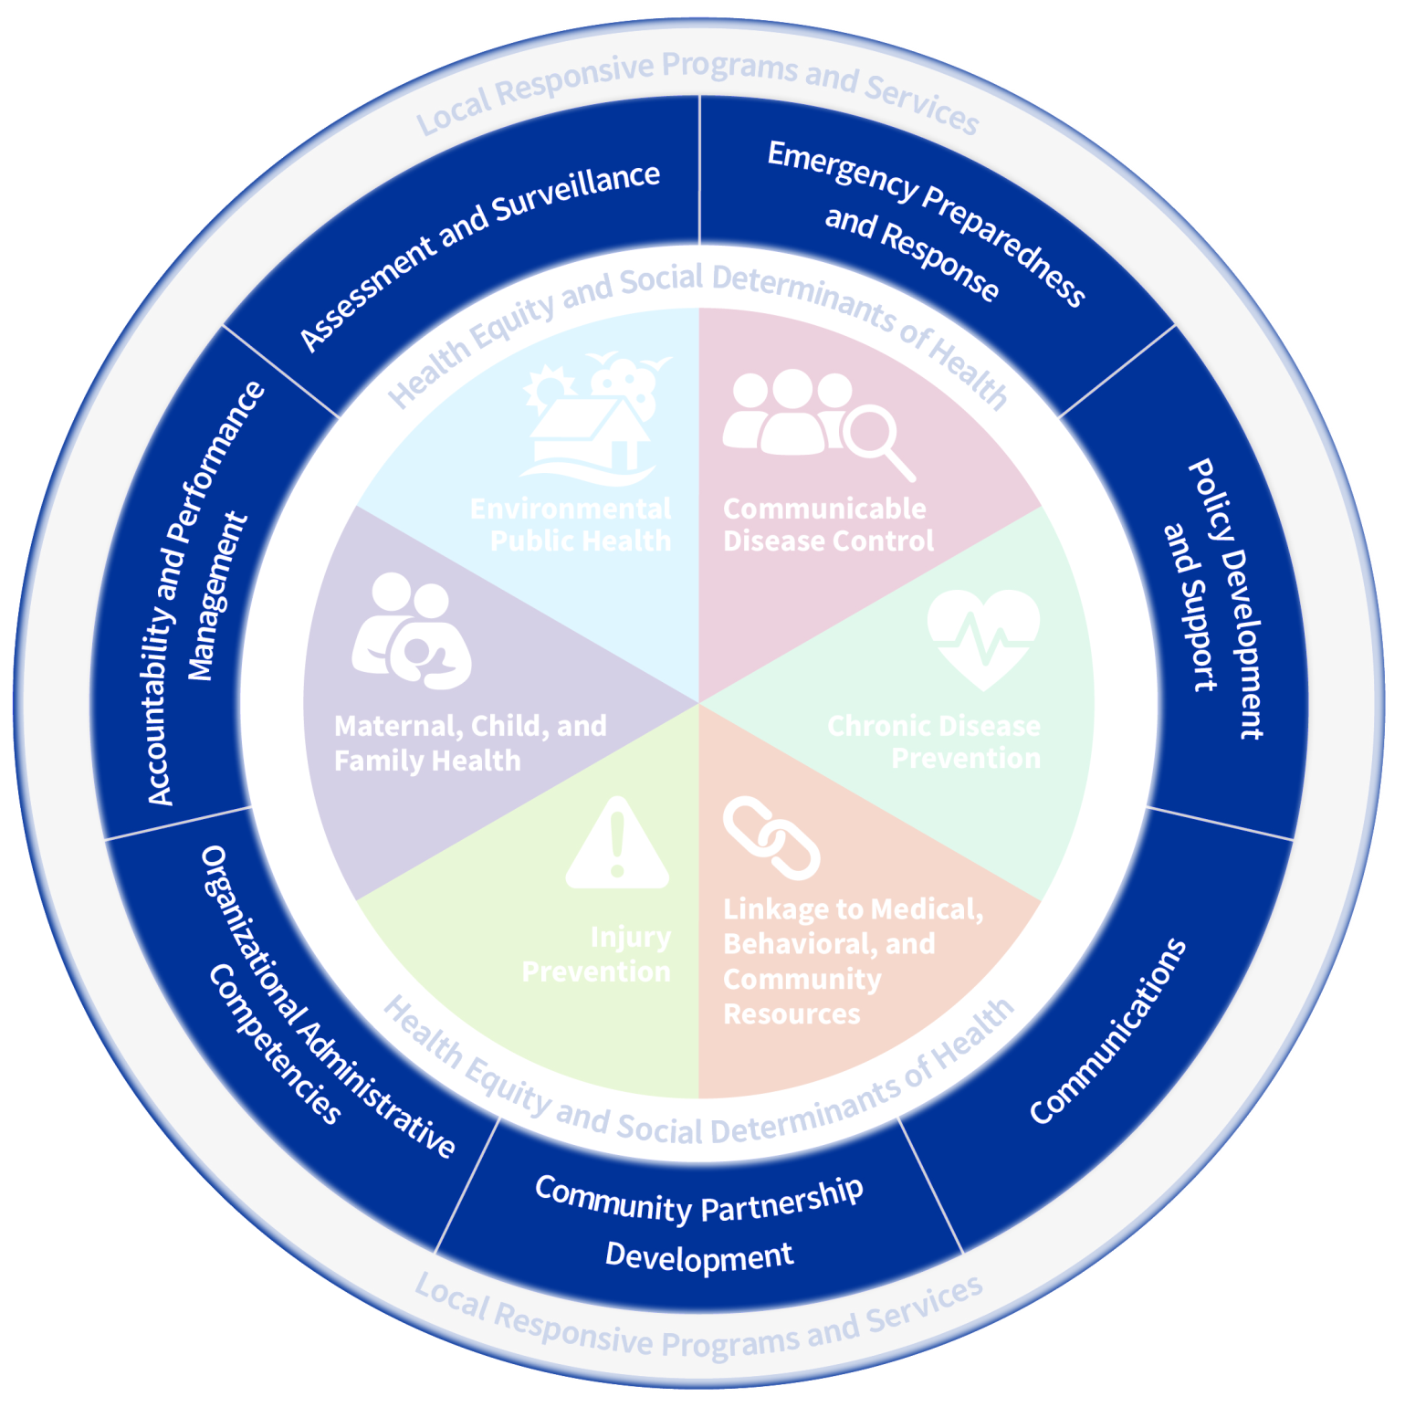
Capabilities
Notes:
Missouri’s model identifies seven cross-cutting skills defined as foundational public health capabilities.
Policy Development and Support
Communications
Community Partnership and Development
Organizational Administrative Competencies
Accountability and Performance Management
Assessment and Surveillance, and
Emergency Preparedness and Response.

Slide 8
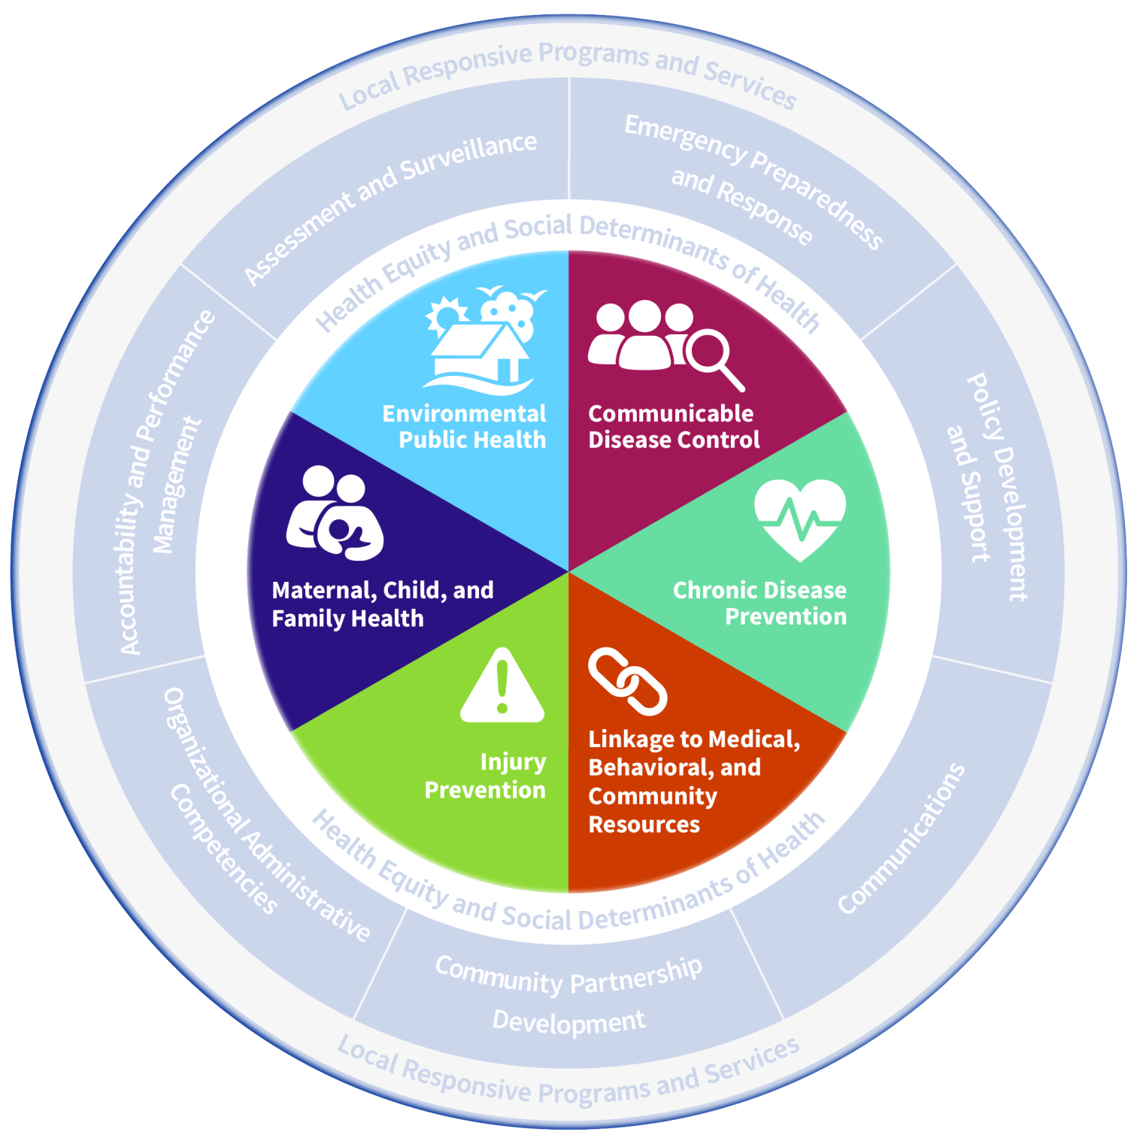
Areas of
Expertise
Notes:
It also defines six interconnected areas of public health expertise:
Communicable Disease Control
Chronic Disease Prevention
Linkage to Medical, Behavioral, and Community Resources
Injury Prevention
Maternal, Child, and Family Health, and
Environmental Public Health.

Slide 9
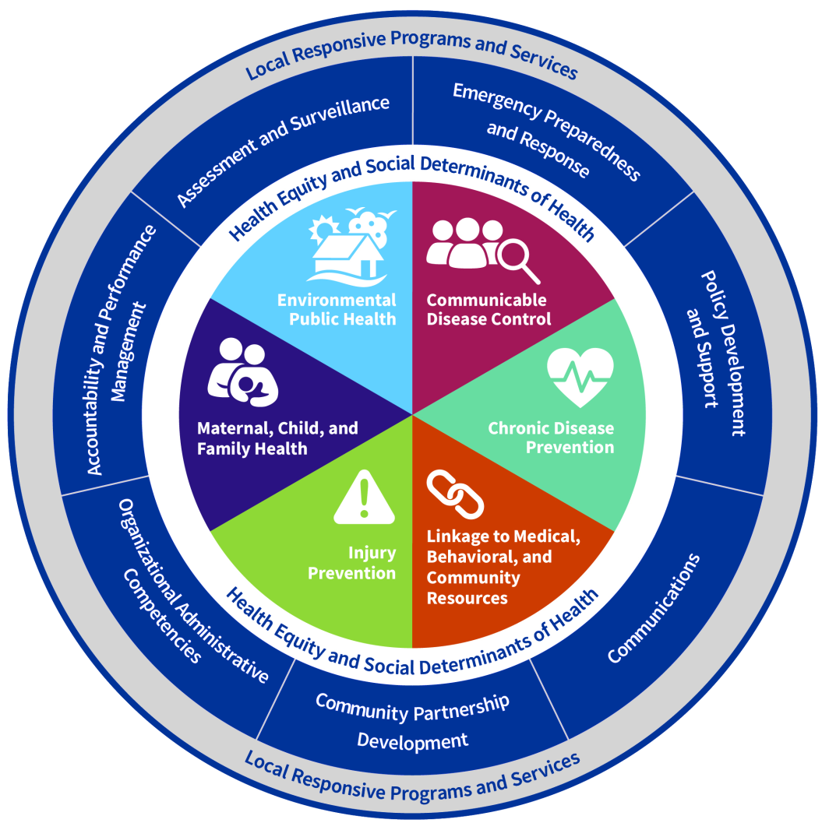
HealthierMO.org
Notes:
Missouri’s model was based on the national model first developed by public health professionals from around the nation, and was informed by models from other states engaged in public health system transformation efforts.

Slide 10
MO vs National Model
Separate Injury Prevention and Chronic Disease
Reword Linkage to Care
Call out Health Equity and SDOH
Add Local Responsive Programs and Services
HealthierMO.org
Notes:
Missouri’s model differs from the national model in four ways:
It separates injury prevention and chronic disease prevention as two distinct areas of expertise.
It adds linkage to behavioral care and community resources under linkage to care.
It recognizes local responsive programs and services as vital to individual communities.
And it calls out health equity and social determinants of health as a lens through which all public health work should be assured.

Slide 11
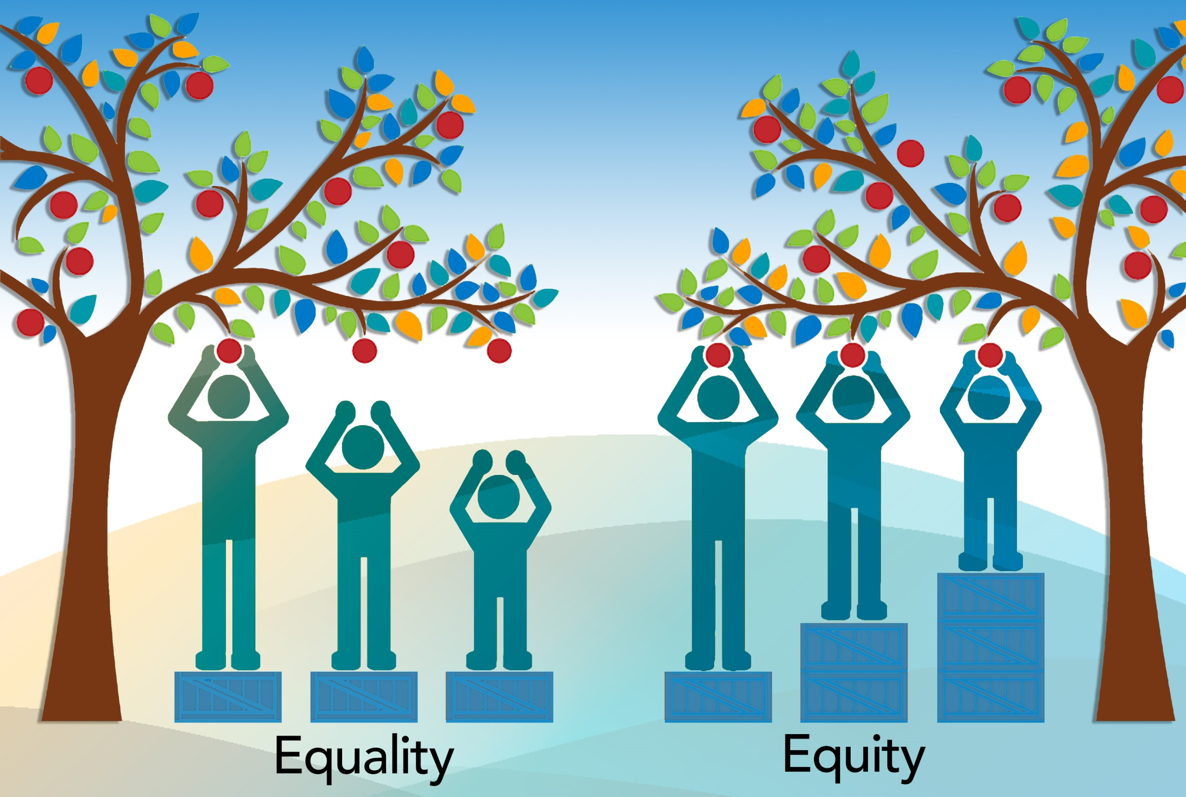
Notes:
Health equity and social determinants of health should be integrated into all public health capabilities and areas of expertise.
Public health agencies must have the ability to work with their partners to address health inequities and social determinants of health in order to create programs and policies that create an environment that supports optimal health for everyone.
Public health agencies should make health equity a strategic priority, use data to identify health inequities, and apply evidence-based strategies and interventions to assure health equity for everyone.

Slide 12
Notes:
[video: shows ring around and pop up to highlight CD]
The model emphasizes the interconnectivity of the cross-cutting skills identified by the capabilities and the public health areas of expertise.
The 2020 Infrastructure and Capacity Assessment survey revealed that local public health agencies who self-assessed a higher capacity to assure the areas of expertise also self-assessed a higher capacity to assure the capabilities.

Slide 13
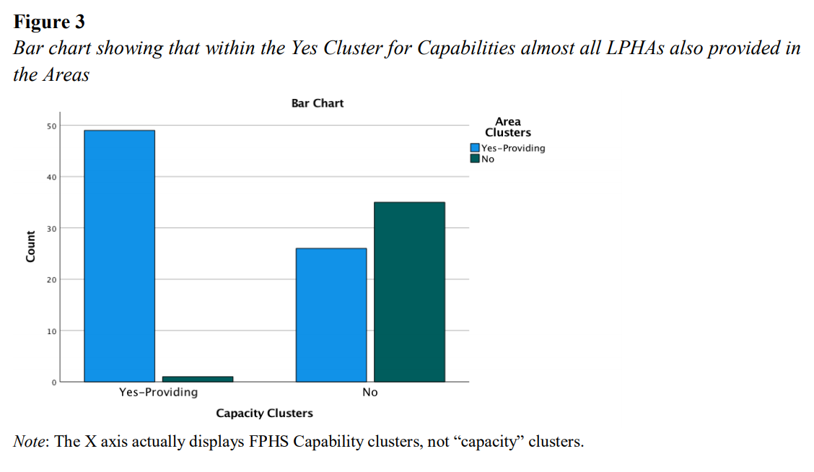
Notes:
Survey analysis showed the areas of expertise depend on capacity in all seven of the capabilities described in the FPHS model.
And while the capacity of areas of expertise is typically dependent on public health professionals that specialize in program areas,
the capacity of the capabilities is highly dependent on a diverse set of administrative skills typically held by the local public health agency director.

Slide 14
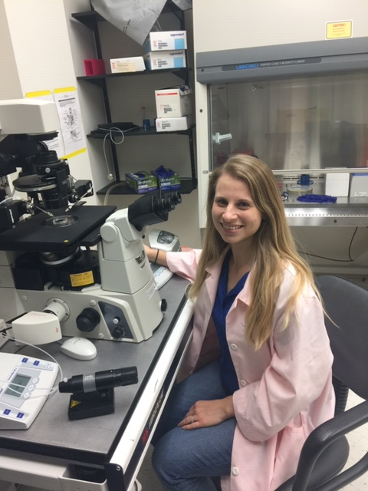
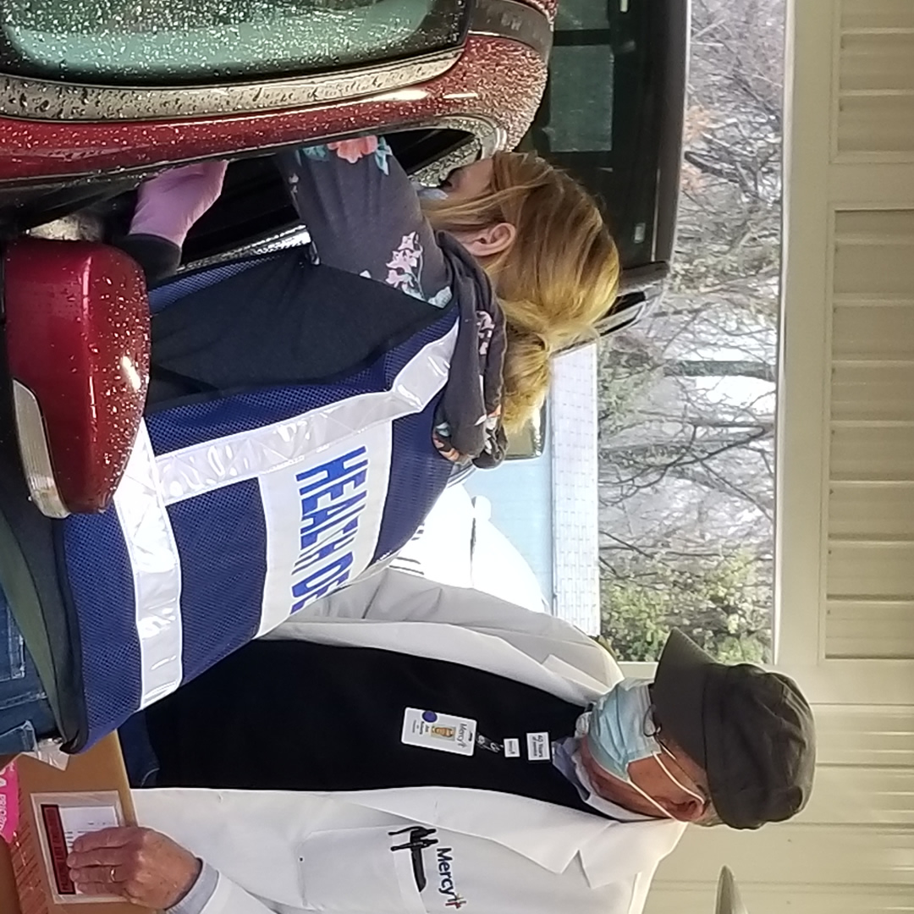
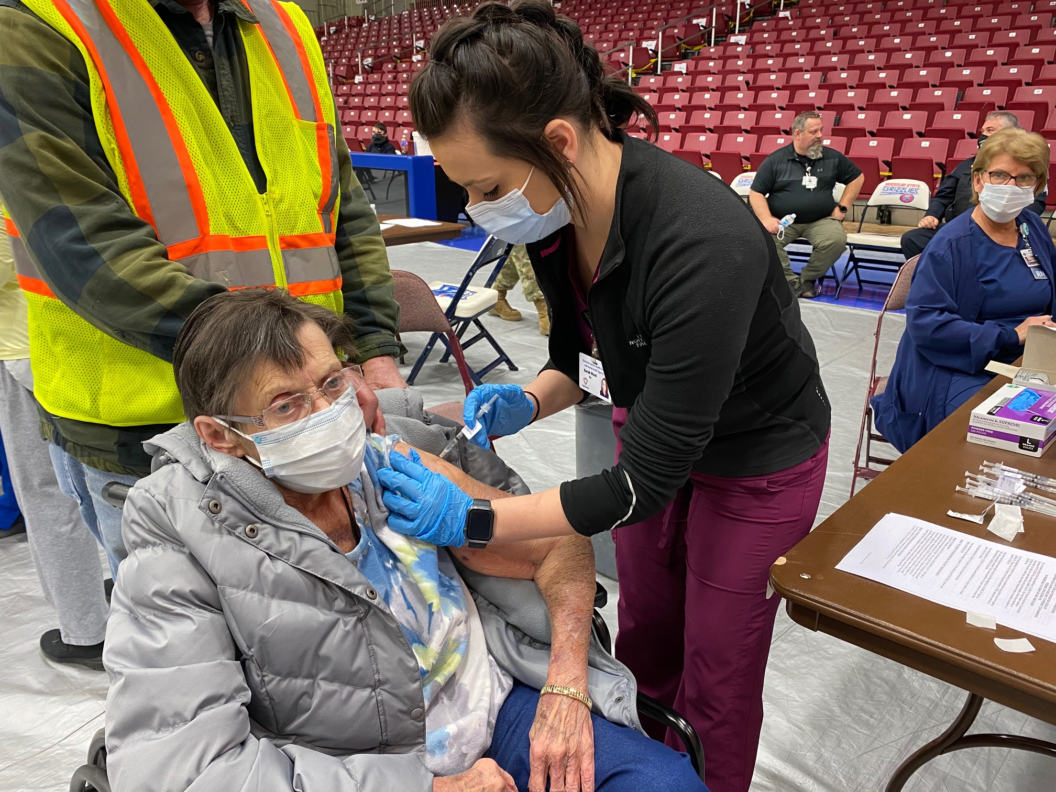
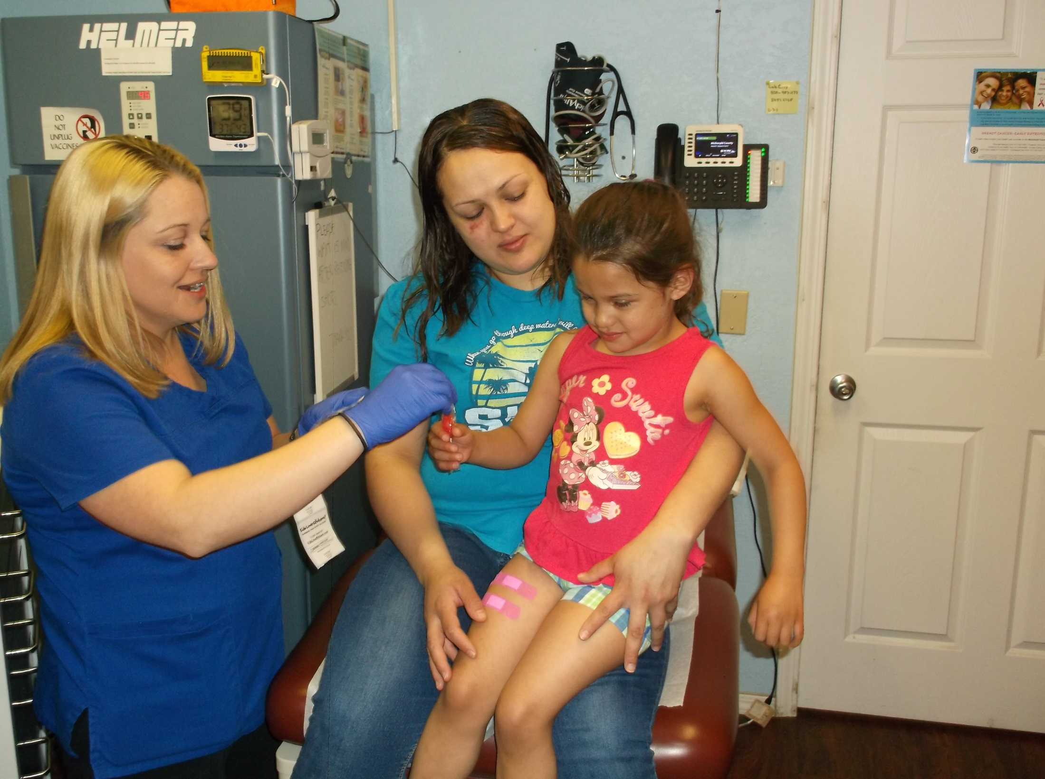
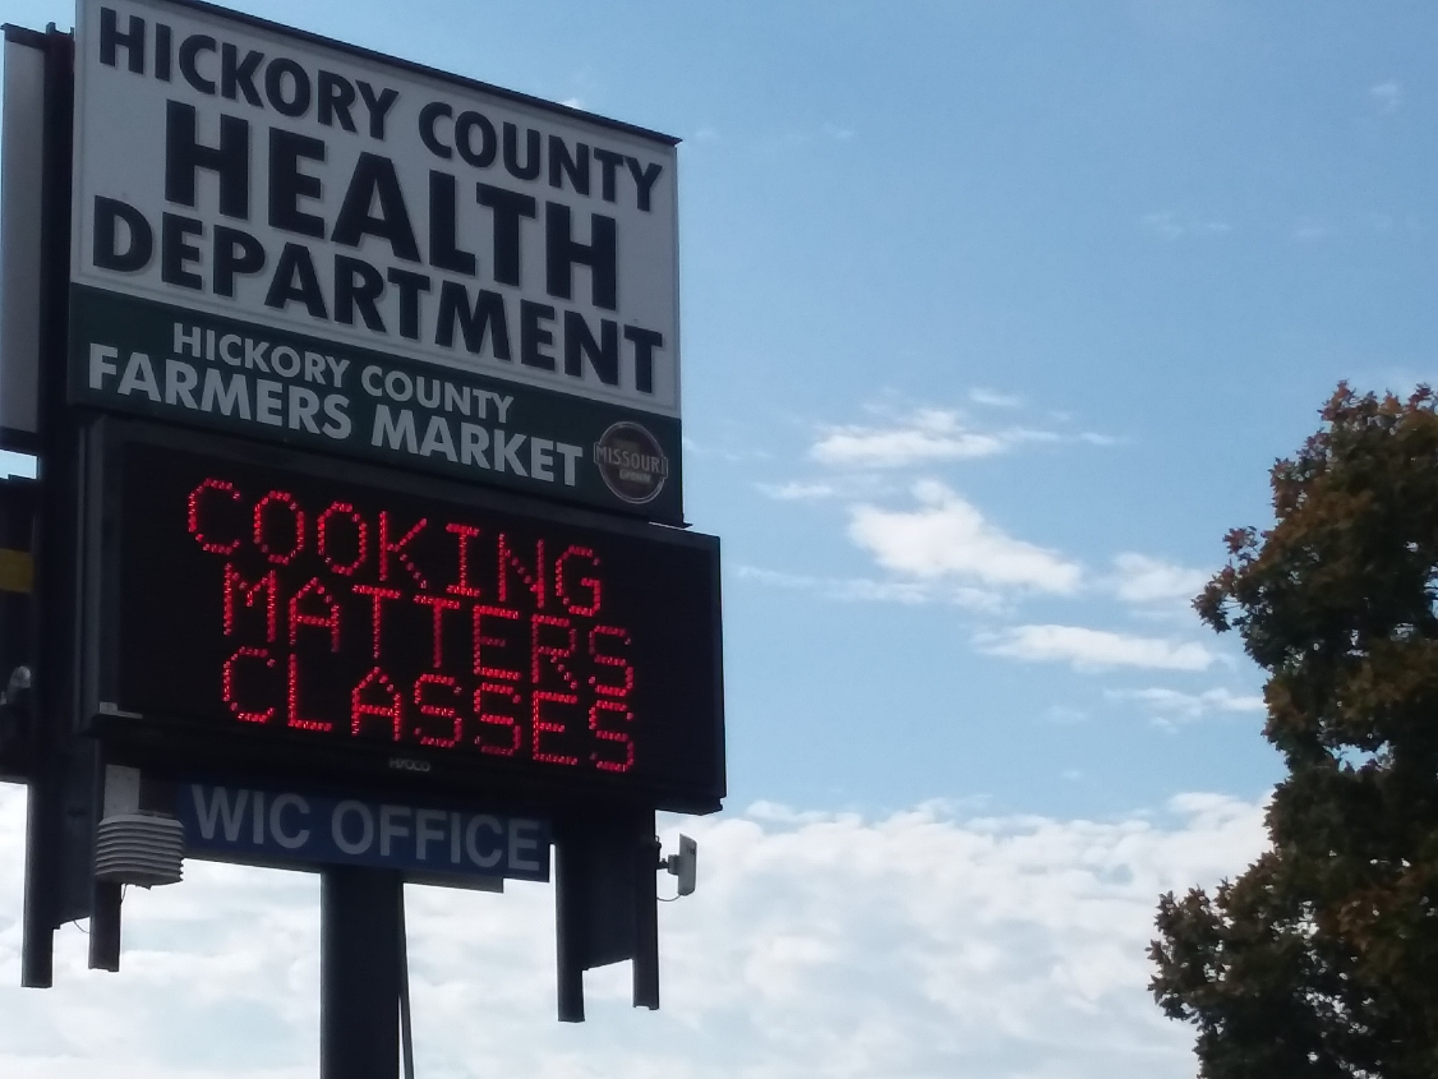
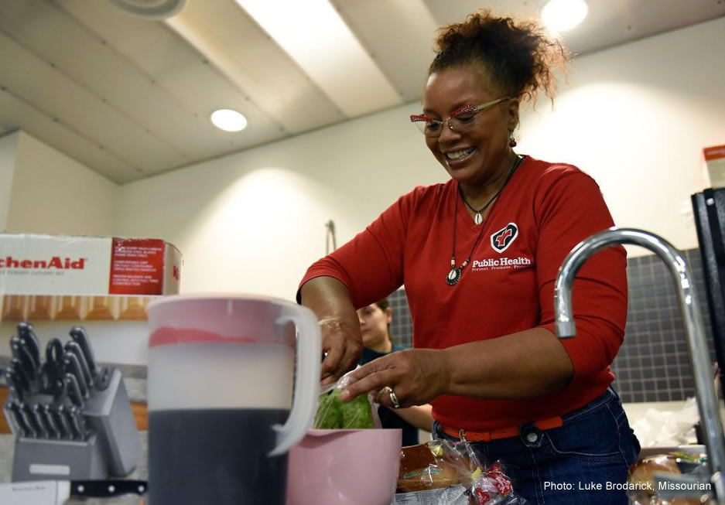
Notes:
Missouri’s local public health agencies are already working to assure foundational public health capabilities and areas of expertise.
They share resources, participate in collaborative partnerships, and look for innovative solutions they can implement to increase public health system capacity.

Slide 15
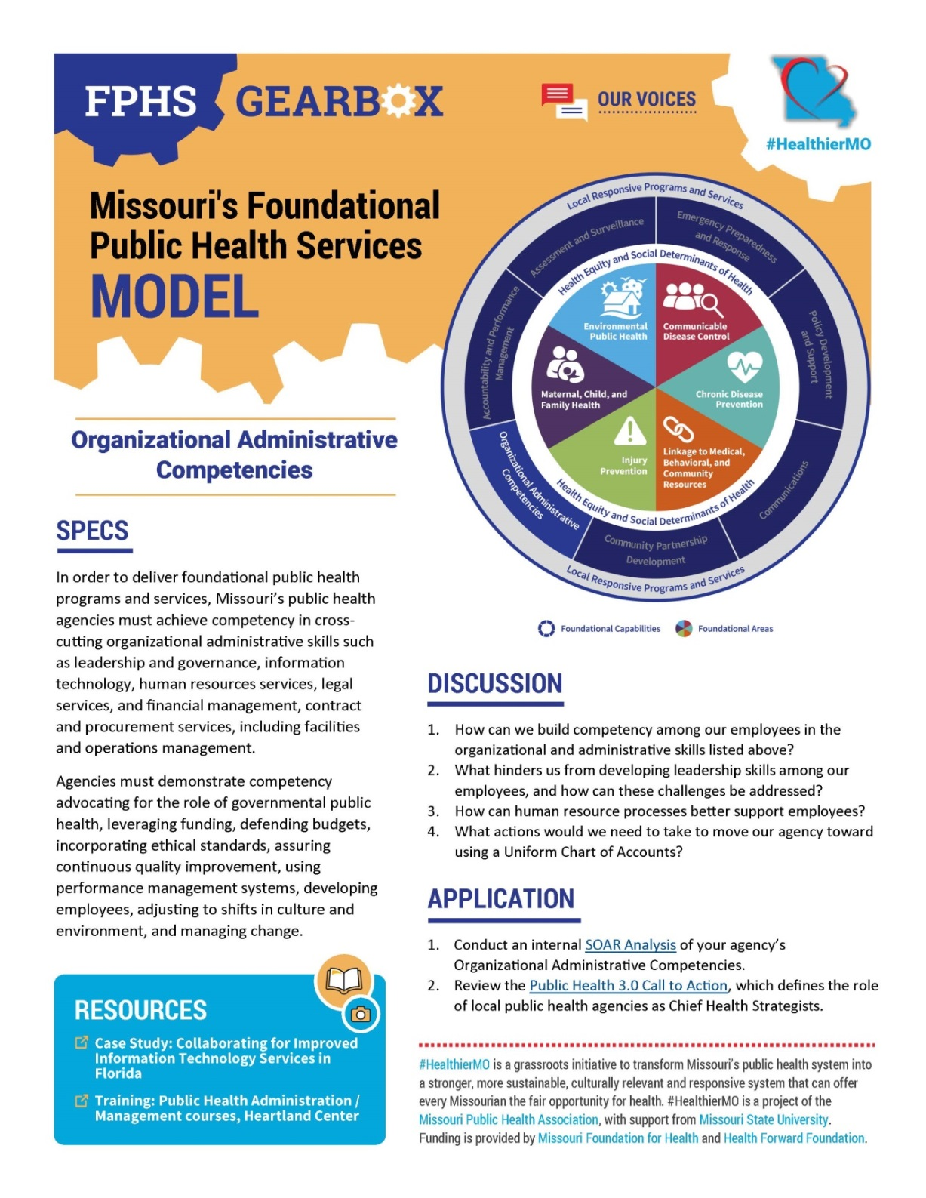
FPHS Model Next Steps
Support public health professionals
Provide a framework for public health system transformation
Explain the role of public health and encourage community level to statewide collaboration
HealthierMO.org
Notes:
Moving forward, the #HealthierMO initiative will create resources to help Missouri’s public health professionals better understand the FPHS model and begin to utilize it as a framework for system transformation.
#HealthierMO also encourages public health professionals to act as ambassadors, using the model during conversations with community members and decision-makers to explain the role of public health and the need for community-wide engagement and collaboration in order to create thriving communities where everyone has the fair opportunity to live their healthiest life.

Slide 16
Learn More
Visit HealthierMO.org
Subscribe to our e-update
Visit our YouTube channel
Choose your role in the transformation initiative
Amplify our content on your social media channels
HealthierMO.org
Notes:
To learn more about the #HealthierMO initiative and Missouri’s Foundational Public Health services model, visit HealthierMO.org.
You can also subscribe to our monthly e-updates and visit our YouTube channel to stay informed.
We hope you’ll choose to actively participate in the grassroots initiative. Amplify our content on your social media channels, and choose a role that fits your skill, interest, and availability.
You’ll find details on our website at HealthierMO.org.

Slide 17
Casey Parnell
Project Manager
cparnell@HealthierMO.org
Jaci McReynolds
Communications Coordinator
jmcreynolds@HealthierMO.org
HealthierMO.org
Notes:
You can also reach out directly to the #HealthierMO staff by email to share your questions and provide input.
Your expertise is valuable in the grassroots initiative to transform Missouri’s public health system.
Together we can build healthier communities and a healthier Missouri!

Slide 18
Notes:
[play video end animation]

